Slide 1
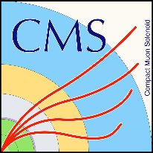

HTTP as a Data Access Protocol: Trials with XrootD
in CMS’ AAA Project
J.R. Vlimant, J. Balcas on behalf of the entire team
The 22nd International Conference on Computing in High Energy and Nuclear Physics, CHEP 2016
San Francisco, 13/10/2016

Slide 2
Motivations and Goals
Motivations:
  CMS Workflow processing requires remote reads (Pileup mixing)
  XrootD is not supported everywhere (Opportunistic)
  Not all sites support XRootD
Goals:
  Demonstrate ability of using HTTP data federations in a manner analogous to today’s AAA infrastructure.
  Improve CMSSW’s HTTP support in case we see increased use of HTTP as a transport protocol.
  Extended to S3 and WebDav.

Slide 3
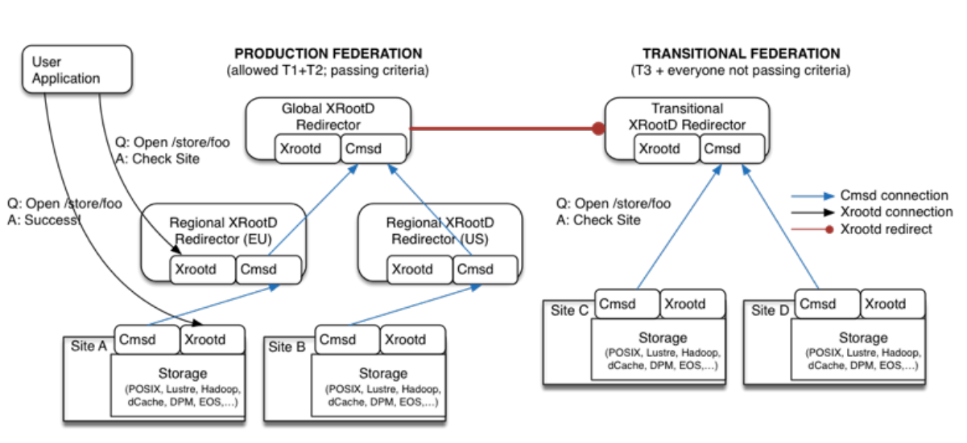
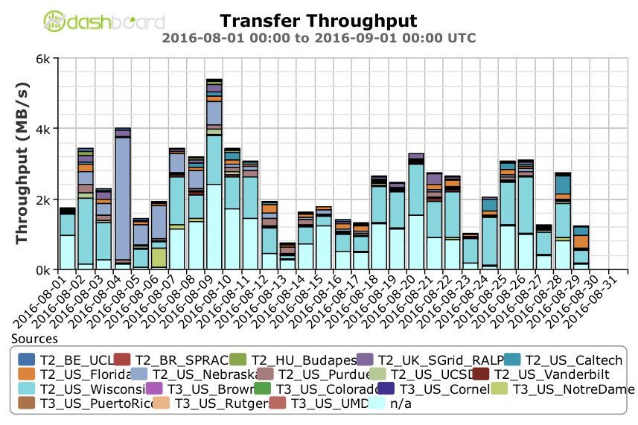
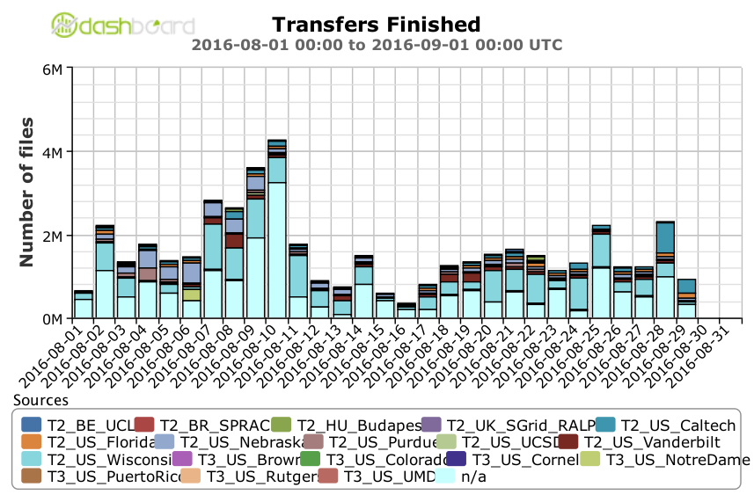
Any Data, Any Time, Anywhere
AAA data federation based on XRootD, this system provides uniform remote data access to all of CMS’s on-disk data.
Workflow management software: HTCondor and glideinWMS provides computing resource provisioning.
Global file systems: To distribute CMS software, we utilize CernVM File System (CVMFS) and have integrated it with Parrot to emulate it on hosts where it is otherwise unavailable.

Slide 4
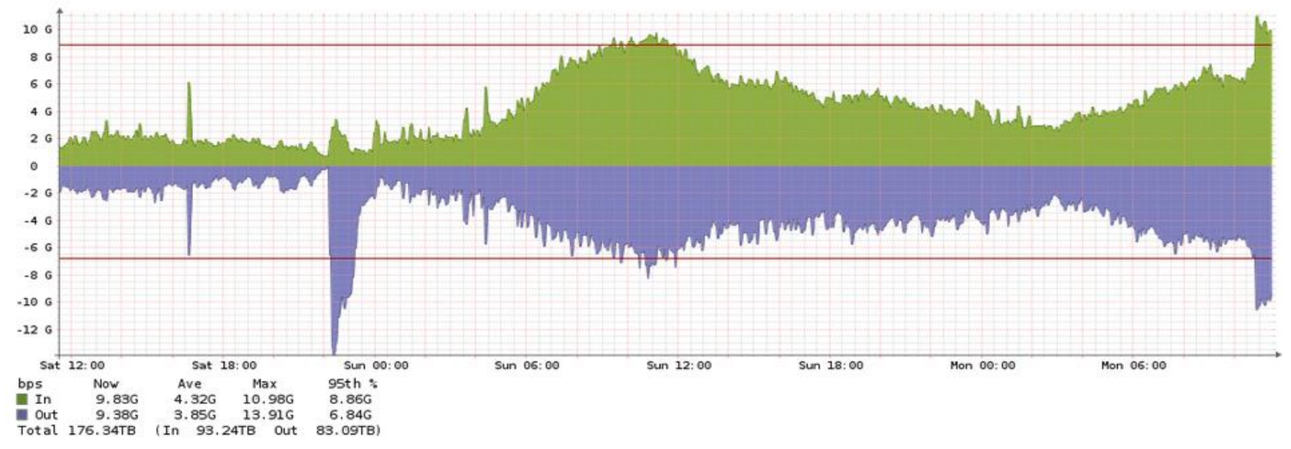
HTTP Data Federation Project in CMS (Operational)
Deliverables: Operational
  Improve support infrastructure at Caltech for data federations; Aim for a system that can saturate 80 Gbps
  Enable HTTP support at the US redirector and at the Caltech site. In collaboration with AAA and Caltech T2
New Infrastructure:
  Started from 1 XRootD server at 10Gbps and moved to 8 active xrootd servers total: 4 production + 4 testbed
  Set up production testbed, added an SSD to one of the nodes to test local FS performance
  New 100Gbps switch between CACR and Lauritsen. Was commissioned on July 2016
  Moving IPAC servers to Lauritsen => heavy data replication took place and link from CACR to Lauritsen was upgraded to 40GE. No apparent congestions or large spikes were noticed.
HTTP support is enabled in Caltech and Nebraska

Slide 5
HTTP Data Federation Project in CMS (Software)
Software Deliverables
  Implement a libdavix-based StorageFactory plugin in CMSSW to replace the current fork/exec of curl for HTTP access
  Develop extensions to the Xrootd [HTTP implementation] to replace any identified missing functionality (e.g. client-based monitoring IDs)
  As necessary, optimize the HTTP implementation within Xrootd to improve any performance deficiencies observed in the tests below
  As necessary, develop patches to better integrate HTTP-over-Xrootd with the OSG distribution (e.g. Authorization)
  (OPTIONAL) Develop asynchronous APIs to libdavix analogous to the current XrootD ones (so we can develop a multistream client for HTTP)
Plugin is available in CMSSW release
  Supports HTTP(s) protocols (http, https)
  Allows to control plugin through environment variables (Davix_DEBUG, X509_*, /tmp/x509up_u%d)
  Vector operations (Partial reads, multi-range, single range) and get full file content to I/O buffer.

Slide 6
HTTP Data Federation Project in CMS (Knowledge)
Deliverables: Knowledge Base
  Document configuration & deployment of HTTP-over-Xrootd at Caltech
  Measure operational performance of a single Xrootd daemon at exporting w/HTTP
  Measure comparative performance in using the Caltech T2 via standard Xrootd versus HTTP through the AAA redirector
  Measure the comparative performance in using ‘curl’-based StorageFactory plugin versus the libdavix one above
  Characterize the performance of using Xrootd for HTTP caching versus squid
Working on understanding Hadoop performance on US CMS Sites:
  Caltech (dd - 650Mbps, xrdcp – 350Mbps), Wisconsin (xrdcp – 350Mbps), Nebraska (asked to do same tests). All tests are done locally from HDFS to /dev/null.
Measured performance of CMSSW caching algorithms and different protocol providers (Apache, Nginx, HttpOverXrootd)
Constructing testbed for HDFS and CEPH storage to estimate the interplay with CMS workflows.

Slide 7
Testbed Setup (Based at Caltech)
Hardware & Software:
  Data Node: CC7, 24gb RAM, 60TB RAID 0, Intel(R) Xeon(R) CPU X5670@2.93Ghz
  Execute Node: SLC6, 64GB RAM, 4TB RAID 0, Intel (R) Xeon(r) CPU E5-2670@2.60Ghz
  No linux or software modifications, default installation. Increased NIC MTU and txqueuelen
Test cases:
  Always running only one job on execute node which reads from Data node on a specific protocol.
Service/Plugin | Davix |  |  | XRootD |  |  | Curl
Apache | Appl | Storage | LazyD |  |  |  |  |  | LazyD
Nginx | Appl | Storage | LazyD |  |  |  |  |  | LazyD
XrootD | Appl | Storage | LazyD | Appl | Storage | LazyD |  |  | LazyD
JobN/Delay | 0 | 2 | 5 | 10 | 15 | 20 | 25 | 30 | 40 | 50 | 60 | 70 | 80 | 90 | 100
0
1
2
3
4
5
6
7
8
9
Percent of Branches/ Trigger Factor [1] | 0 | 1 | 20
1
30
100
[1] - https://github.com/cms-sw/cmssw/blob/CMSSW_8_1_X/IOPool/Input/doc/IOExerciser-README

Slide 8
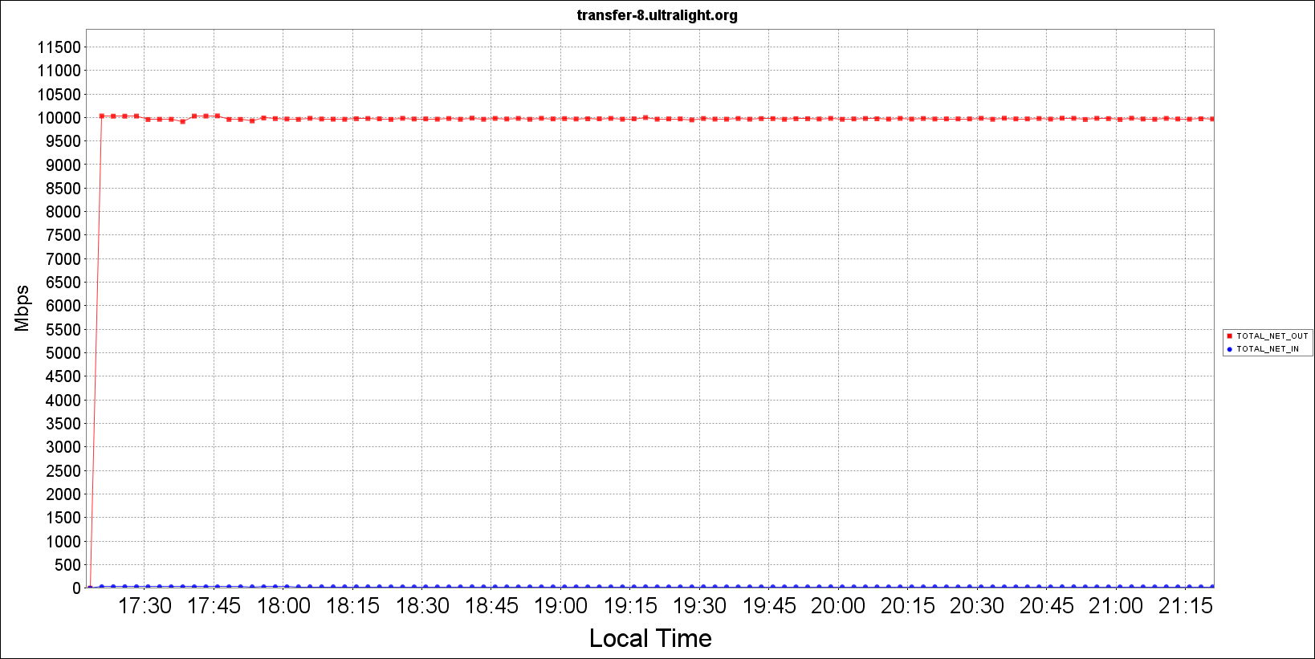
Tesbed environment performance
Nettest – stable 9.9 Gb/s
Storage write/read speed
Data node
  Timing cached reads:
  18312 MB in 2 seconds = 9.2 GB/sec
  Timing buffered disk reads:
  6974 MB in 3 seconds = 2.3 GB/sec
  Write speed:
  2.1 GB copied, 1.70 s, 1.3 GB/s
Execute node
  Timing cached reads:
  17884 MB in 2 seconds = 9.0 GB/sec
  Timing buffered disk reads:
  5952 MB in 3 seconds = 1.9 GB/sec
  Write speed:
  2.1 GB copied, 2.2 s, 1.0 GB/s
No limitations from hardware
Used tools:
FDT – Application For Fast Data Transfers over WAN
Monalisa – Monitoring agents for the end hosts

Slide 9
Transfer test: xrdcp vs curl vs fdt (Mbytes/s)
 | 0 | 2 | 5 | 10 | 15 | 20 | 25 | 30 | 40 | 50 | 60 | 70 | 80 | 90 | 100
xrdcp (4streams) | 1046 | 1130 | 982 | 561 | 357 | 302 | 192 | 163 | 157 | 133 | 128 | 109 | 80 | 64 | 62
xrdcp (8streams) | 1046 | 1130 | 982 | 655 | 393 | 327 | 196 | 164 | 164 | 136 | 136 | 114 | 76 | 72 | 59
fdt (2streams) | 901 | 900 | 850 | 842 | 805 | 777 | 732 | 684 | 548 | 439 | 352 | 282 | 226 | 181 | 163
fdt (15streams) | 1123 | 1074 | 1023 | 880 | 757 | 651 | 561 | 482 | 415 | 357 | 307 | 264 | 227 | 196 | 188
Curl | 508 | 408 | 445 | 269 | 200 | 150 | 126 | 100 | 63 | 45 | 39 | 36 | 33 | 30 | 28
Only highest values are shown.
FDT scales better with Round Trip Time

Slide 10
Compare CMSSW caching types (Mbytes/s)
 | 0 | 2 | 5 | 10 | 15 | 20 | 25 | 30 | 40 | 50 | 60 | 70 | 80 | 90 | 100
LazyDownload (Nginx Davix) | 767.20 | 641.15 | 426.37 | 226.71 | 158.89 | 123.77 | 87.59 | 85.97 | 65.65 | 53.80 | 45.88 | 39.99 | 34.55 | 28.83 | 24.86
Application (XrootD XrootD) | 671.08 | 314.64 | 301.17 | 182.89 | 125.66 | 103.33 | 76.77 | 73.09 | 56.82 | 42.72 | 38.70 | 31.49 | 29.64 | 27.35 | 3.98
Storage (XrootD Davix) | 95.14 | 14.17 | 7.29 | 3.73 | 2.52 | 1.98 | 1.58 | 1.19 | 1.01 | 0.81 | 0.61 | 0.46 | 0.35 | 0.25 | 0.25
Only highest values are shown.
No advantage in Storage Caching

Slide 11
Application caching (Mbytes/s)
 | 0 | 2 | 5 | 10 | 15 | 20 | 25 | 30 | 40 | 50 | 60 | 70 | 80 | 90 | 100
ApacheDavixApplication | 603.76 | 346.05 | 229.81 | 110.70 | 41.44 | 77.98 | 23.21 | 32.29 | 15.46 | 40.70 | 34.17 | 30.73 | 25.11 | 24.54 | 4.54
XrootdApplication | 671.08 | 314.64 | 301.17 | 182.89 | 125.66 | 103.33 | 76.77 | 73.09 | 56.82 | 42.72 | 38.70 | 31.49 | 29.64 | 27.35 | 3.98
XrootDDavixApplication | 472.03 | 60.43 | 74.58 | 41.18 | 26.80 | 19.74 | 16.30 | 13.02 | 10.11 | 5.52 | 6.80 | 6.01 | 4.90 | 4.68 | 3.88
NginxDavixApplication | 515.68 | 171.24 | 239.83 | 146.58 | 97.47 | 77.84 | 22.40 | 18.34 | 28.54 | 36.21 | 30.03 | 25.41 | 24.27 | 21.71 | 5.76
Only highest values are shown.
Suspicious low performance of HTTP over XRootD

Slide 12
Lazy download caching (Mbytes/s)
 | 0 | 2 | 5 | 10 | 15 | 20 | 25 | 30 | 40 | 50 | 60 | 70 | 80 | 90 | 100
ApacheDavixLazy | 728.07 | 481.99 | 300.67 | 174.24 | 114.28 | 102.27 | 90.12 | 73.82 | 57.31 | 46.95 | 39.20 | 31.26 | 28.29 | 24.82 | 13.45
XrootDXrootdLazy | 570.48 | 495.74 | 339.24 | 202.74 | 149.33 | 123.12 | 63.36 | 85.14 | 65.48 | 29.87 | 43.75 | 38.48 | 34.14 | 29.06 | 18.31
XrootDCurlLazy | 507.62 | 408.10 | 445.43 | 269.26 | 200.13 | 149.63 | 125.69 | 99.72 | 62.54 | 45.21 | 38.83 | 36.07 | 32.85 | 29.86 | 27.61
XrootDDavixLazy | 825.41 | 509.48 | 430.19 | 243.66 | 171.29 | 131.78 | 103.44 | 83.80 | 66.05 | 34.39 | 45.64 | 40.07 | 34.37 | 30.13 | 18.31
ApacheCurlLazy | 471.46 | 478.04 | 454.13 | 284.73 | 203.37 | 147.80 | 126.97 | 88.60 | 64.98 | 52.96 | 40.54 | 38.59 | 34.46 | 29.93 | 27.44
NginxDavixLazy | 767.20 | 641.15 | 426.37 | 226.71 | 158.89 | 123.77 | 87.59 | 85.97 | 65.65 | 53.80 | 45.88 | 39.99 | 34.55 | 28.83 | 24.86
NginxCurlLazy | 485.23 | 470.43 | 441.40 | 273.27 | 194.31 | 151.05 | 123.62 | 102.66 | 64.25 | 48.19 | 40.35 | 36.27 | 33.28 | 29.89 | 26.42
Everything seems to be the same

Slide 13
Summary
Testbed setup at Caltech, installed and used for performance tests
Implemented Davix Storage Factory plugin in CMSSW
  Performed initial performance test with XRootD, Davix, Curl
CMSSW caching outcome:
  Storage caching is slowest. Huge impact on total job efficiency through any access type starting from 2ms delay.
  HTTP Application caching shows much better performance through Apache or Nginx than through HTTP over XrootD
  Lazy download - All are near same bounds with average small difference. Davix plugin through Nginx or HTTP over XrootD always shows a bit better throughput than XrootD plugin

Slide 14
Outlook
Implement S3 and WebDav in CMSSW and have it in next CMSSW release
Average production job Runtime is ~5 hours and LONG TCP connections lead to failures/inefficiency’s:
  Once TCP connection made, in case of failure, whole job is considered as failed, no retries to re-open a file;
  Network, IO, CPU usage changes over the time;
Develop retry logic in CMSSW and allow sites control it. Also jobs could overwrite it through configuration knobs:
  How many times to retry
  Timeout between retries
Move all xrootd servers to CC7 (Issues with SLC6)
Improve XrootD monitoring to see the correct throughput, num. of connections, failures.
Make sure failed sites are reported
Collect and analyze production job efficiency metrics in real time and improve their efficiency

Slide 16
BACKUP SLIDES

Slide 17
Comparing xrdcp vs curl vs fdt (Mbytes/s)

Slide 18
Storage caching (Mbytes/s)
 | 0 | 2 | 5 | 10 | 15 | 20 | 25 | 30 | 40 | 50 | 60 | 70 | 80 | 90 | 100
ApacheDavixStorage | 89.43 | 12.70 | 5.76 | 3.02 | 2.06 | 1.56 | 1.26 | 0.99 | 0.84 | 0.66 | 0.50 | 0.42 | 0.34 | 0.21 | 0.13
XrootDXrootdStorage | 123.04 | 15.31 | 7.42 | 3.72 | 2.47 | 1.87 | 1.50 | 1.12 | 0.95 | 0.76 | 0.57 | 0.43 | 0.34 | 0.24 | 0.13
XrootDDavixStorage | 95.14 | 14.17 | 7.29 | 3.73 | 2.52 | 1.98 | 1.58 | 1.19 | 1.01 | 0.81 | 0.61 | 0.46 | 0.35 | 0.25 | 0.25
NginxDavixStorage | 101.62 | 12.82 | 5.77 | 3.03 | 2.05 | 1.56 | 1.25 | 0.98 | 0.83 | 0.66 | 0.50 | 0.42 | 0.34 | 0.21 | 0.12

Slide 19
Overall Results (Average read time in seconds)

Slide 20
CMSSW caching hints
CMSSW normally reads data via a set of I/O adaptors. The interface between CMSSW and ROOT is called TFileAdaptor. The underlying C++ interface for POSIX-like storage objects is called StorageFactory.
Application:
  This is the default and means ROOT will do the caching. If PoolSource.cacheSize is non-zero, a TTreeCache of that size will be created per open file. Asynchronous read-ahead will be turned off and the cache will be filled with normal reads.
Storage:
  ROOT will drive the caching using a prefetch list, but will not allocate a cache of its own. ROOT will hand over the prefetch list to the storage layer, which is expected to do its own caching.
Lazy-download:
  Remote files will be downloaded to a local shadow file on demand in 128MB segments. ROOT reads will be directed to this local file; ROOT will never read directly from the remote file.

Slide 21
Software used in tests
Apache is the most widely used web server software. Developed and maintained by Apache Software Foundation, Apache is an open source software available for free.
Nginx is a web server. It can act as a reverse proxy server for TCP, UDP, HTTP, HTTPS, SMTP, POP3, and IMAP protocols, as well as a load balancer and an HTTP cache.
XRootD software framework is a fully generic suite for fast, low latency and scalable data access, which can serve natively any kind of data, organized as a hierarchical filesystem-like namespace, based on the concept of directory.
FDT is an Application for Efficient Data Transfers which is capable of reading and writing at disk speed over wide area networks (with standard TCP). It is written in Java, runs an all major platforms and it is easy to use.

